Slide 1

Web Application Development
COMP-229

Slide 2
Adding user CRUD APIs
The user API endpoints exposed by the Express app will allow the frontend to perform CRUD operations on documents that are generated according to the user model.
To implement these working endpoints, we will write Express routes and the corresponding controller callback functions that should be executed when HTTP requests come in for these declared routes.
In this section, we will look at how these endpoints work without any auth restrictions.
Our user API routes will be declared using the Express router in server/routes/user.routes.js, and then mounted on the Express app we configured in server/express.js.

Slide 3
Express.js
mern-skeleton/server/express.js:
import userRoutes from './routes/user.routes’
...
app.use('/', userRoutes)
...

Slide 4
Updated express.js
import express from 'express'
import bodyParser from 'body-parser'
import cookieParser from 'cookie-parser'
import compress from 'compression'
import cors from 'cors'
import helmet from 'helmet'
import Template from './../template'
import userRoutes from './routes/user.routes.js'
const app = express()
//...
app.get('/', (req, res) => {
res.status(200).send(Template())
})
//...
app.use('/', userRoutes)
app.use(bodyParser.json())
app.use(bodyParser.urlencoded({ extended: true }))
app.use(cookieParser())
app.use(compress())
app.use(helmet())
app.use(cors())
export default app

Slide 5
All routes and API endpoints, such as the user-specific routes we'll declare next, need to be mounted on the Express app so that they can be accessed from the client-side.

Slide 6
User routes
The user routes that are defined in the user.routes.js file will use express.Router() to define route paths with the relevant HTTP methods and assign the corresponding controller function that should be called when these requests are received by the server.
We will keep the user routes simplistic by using the following:
/api/users for the following:
Listing users with GET
Creating a new user with POST
/api/users/:userId for the following:
Fetching a user with GET
Updating a user with PUT
Deleting a user with DELETE

Slide 7
User routes Contd.
The resulting user.routes.js code will look as follows (without the auth considerations that need to be added for protected routes).

Slide 8
user.routes.js
mern-skeleton/server/routes/user.routes.js:
import express from 'express'
import userCtrl from '../controllers/user.controller.js'
const router = express.Router()
router.route('/api/users').post(userCtrl.create)
router.route('/api/users').get(userCtrl.list)
router.param('userId', userCtrl.userByID)
router.route('/api/users/:userId').get(userCtrl.read)
router.route('/api/users/:userId').put(userCtrl.update)
router.route('/api/users/:userId').delete(userCtrl.remove)
export default router

Slide 9
Besides declaring API endpoints that correspond to user CRUD operations, we'll also configure the Express router so that it handles the userId parameter in a requested route by executing the userByID controller function.
When the server receives requests at each of these defined routes, the corresponding controller functions are invoked. We will define the functionality for each of these controller methods and export it from the user.controller.js file in the next subsection.

Slide 10
User controller
The server/controllers/user.controller.js file will contain definitions of the controller methods that were used in the preceding user route declarations as callbacks to be executed when a route request is received by the server.

Slide 11
User.controller.js
mern-skeleton/server/controllers/user.controller.js:
import User from '../models/user.model.js'
import extend from 'lodash/extend.js'
import errorHandler from './error.controller.js'
const create = async (req, res) => {
const user = new User(req.body)
try {
await user.save()
return res.status(200).json({
message: "Successfully signed up!"
})
} catch (err) {
return res.status(400).json({
error: errorHandler.getErrorMessage(err)
})
}
}
const list = async (req, res) => {
try {
let users = await User.find().select('name email updated created')
res.json(users)
} catch (err) {
return res.status(400).json({
error: errorHandler.getErrorMessage(err)
})
}
}
const userByID = async (req, res, next, id) => {
try {
let user = await User.findById(id)
if (!user)
return res.status('400').json({
error: "User not found"
})
req.profile = user
next()
} catch (err) {
return res.status('400').json({
error: "Could not retrieve user"
})
}
}
const read = (req, res) => {
req.profile.hashed_password = undefined
req.profile.salt = undefined
return res.json(req.profile)
}
const update = async (req, res) => {
try {
let user = req.profile
user = extend(user, req.body)
user.updated = Date.now()
await user.save()
user.hashed_password = undefined
user.salt = undefined
res.json(user)
} catch (err) {
return res.status(400).json({
error: errorHandler.getErrorMessage(err)
})
}
}
const remove = async (req, res) => {
try {
let user = req.profile
let deletedUser = await user.deleteOne()
deletedUser.hashed_password = undefined
deletedUser.salt = undefined
res.json(deletedUser)
} catch (err) {
return res.status(400).json({
error: errorHandler.getErrorMessage(err)
})
}
}
export default { create, userByID, read, list, remove, update }

Slide 12
Code Explanation
Create User (create):
Creates a new user with the data from req.body and saves it to the database.
On success, returns a success message.
On error, returns an error message.
List Users (list):
Retrieves a list of users, selecting specific fields (name, email, updated, created).
Returns the list of users or an error message.
Get User by ID (userByID):
Middleware to find a user by ID and attach it to req.profile.
If the user is not found, returns an error message.
If the user is found, proceeds to the next middleware or route handler.

Slide 13
Code Explanation contd.
4. Read User (read):
Returns the user profile with sensitive information (password and salt) removed.
5. Update User (update):
Updates the user profile with data from req.body and the current timestamp.
Saves the updated user profile to the database.
Returns the updated profile with sensitive information removed, or an error message on failure.
6. Remove User (remove):
Deletes the user profile from the database.
Returns the deleted user profile with sensitive information removed, or an error message on failure.

Slide 14
error.controller.js
In the controller folder create a file called error.controller.js to handle any error as follows:
function handleError(req, res) {
// Your code to handle the error
}
function getErrorMessage(errMsg) {
console.log(errMsg);
}
// Export the controller function
export default {
handleError: handleError,
getErrorMessage:getErrorMessage
};

Slide 15
This controller will make use of the errorHandler helper to respond to route requests with meaningful messages when a Mongoose error occurs.
It will also use a module called lodash when updating an existing user with changed values.
lodash is a JavaScript library that provides utility functions for common programming tasks, including the manipulation of arrays and objects.
To install lodash, run yarn add lodash from the command line, i.e terminal, root.

Slide 16
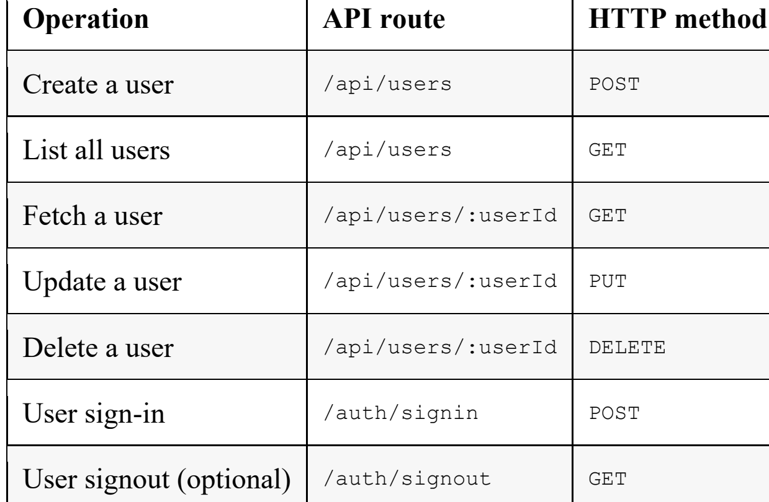
Each of the controller functions we defined previously is related to a route request.
Routes | controllers

Slide 17
From the terminal type the command:
Yarn add lodash or npm install lodash

Slide 18
This function creates a new user with the user JSON object that's received in the POST request from the frontend within req.body.
The call to user.save attempts to save the new user in the database after Mongoose has performed a validation check on the data. Consequently, an error or success response is returned to the requesting client.
The create function is defined as an asynchronous function with the async keyword, allowing us to use await with user.save(), which returns a Promise. Using the await keyword inside an async function causes this function to wait until the returned Promise resolves, before the next lines of code are executed.
If the Promise rejects, an error is thrown and caught in the catch block.

Slide 19
Async/await is an addition to ES8 that allows us to write asynchronous JavaScript code in a seemingly sequential or synchronous manner.
For controller functions that handle asynchronous behavior such as accessing the database, the async/await syntax is used to implement them.
we will use async/await while implementing the
controller function to list all users after querying the database.

Slide 20
When the Express app gets a GET request at '/api/users', it executes the list controller function.

Slide 21
Updated user.model.js
import mongoose from 'mongoose'
//const mongoose = require('mongoose');
const UserSchema = new mongoose.Schema({
name: {
type: String,
trim: true,
required: 'Name is required'
},
email: {
type: String,
trim: true,
unique: 'Email already exists',
match: [/.+\@.+\..+/, 'Please fill a valid email address'],
required: 'Email is required'
},
created: {
type: Date,
default: Date.now
},
updated: {
type: Date,
default: Date.now
},
hashed_password: {
type: String,
required: 'Password is required'
},
salt: String
});
UserSchema.virtual('password')
.set(function(password) {
this._password = password;
//this.salt = this.makeSalt();
this.hashed_password = password;
//this.hashed_password = this.encryptPassword(password);
})
.get(function() {
return this._password;
});
UserSchema.path('hashed_password').validate(function(v) {
if (this._password && this._password.length < 6) {
this.invalidate('password', 'Password must be at least 6 characters.');
}
if (this.isNew && !this._password) {
this.invalidate('password', 'Password is required');
}
}, null);
//module.exports = mongoose.model('User', UserSchema);
export default mongoose.model('User', UserSchema);

Slide 22
Updated express.js
Update the express.js as follows:
import express from 'express'
import bodyParser from 'body-parser'
import cookieParser from 'cookie-parser'
import compress from 'compression'
import cors from 'cors'
import helmet from 'helmet'
import Template from './../template.js'
import userRoutes from './routes/user.routes.js'
const app = express()
//...
app.get('/', (req, res) => {
res.status(200).send(Template())
})
//...
app.use(express.json());
app.use(express.urlencoded({ extended: true }));
app.use('/', userRoutes)
app.use(bodyParser.json())
app.use(bodyParser.urlencoded({ extended: true }))
app.use(cookieParser())
app.use(compress())
app.use(helmet())
app.use(cors())
export default app

Slide 23
• app.use(express.json()):
Purpose: This middleware parses incoming requests with JSON payloads.
Functionality: When a request comes in with a Content-Type of application/json, this middleware parses the JSON payload and makes it available in req.body.
• app.use(express.urlencoded({ extended: true })):
Purpose: This middleware parses incoming requests with URL-encoded payloads.
Functionality:
extended: true: This option allows for rich objects and arrays to be encoded into the URL-encoded format, using the qs library. This means you can parse nested objects.
When to use: Typically used for parsing form submissions where form data is sent as application/x-www-form-urlencoded.

Slide 24
Install method-override at the command prompt i.e terminal or root using the following command:
Yarn add method-override

Slide 25
cd client
yarn dev to run the application

